Slide 1
Greg Focaccio - Employee Brief
Greg Focaccio
Code #
IT Specialist
Month Day, 2025
1

Slide 2
Greg Focaccio – BLUF Bio
Greg Focaccio is a native San Diegan with over 15 years of hands-on Network Engineering experience. He has worked as Lead Engineer at multiple Internet Service Providers, and network consulting companies and has extensive datacenter experience.
He has been married for 16 years. He has three children at home, three grown step-children, and 4 grandkids. He enjoys learning about and experimenting with new network technologies in his garage lab. He enjoys camping with family, hiking in the local desert and mountains, bodysurfing, and tennis.
He joined NIWC PAC 4 years ago (2021) to work on the X Project in Code X and became a Civilian Navy employee 2 years ago (2023).
He is proud to be working at NIWC PAC and hopes to remain here for the duration of his career. He has made key technical contributions to the X project and plans to continue in the same role while also looking ahead for opportunities to manage technical teams and support other project’s networking needs.
3

Slide 3
Greg Focaccio - Audience Attention
[Picture of: Transmission Line, Comm Link/ Network Map, AI]
Besides electrical power, what do modern weapon systems require to be useful?
Hint: It’s part of NIWC’s name
<Answer1>
Is <Answer1> useful if is it stays in one place or is confined to one system?
No.
How does <Answer1> move from place to place and system to system?
<Answer2>
<Answer2>, is what I do. My work is to delivering <Answer2> solutions.
Seek me out if you have a <Answer2> requirement that needs a solution!
Note: This is only becoming increasingly important.
What is coming next?
Intelligence. Intelligence also need to move around, so <Answer 2> is becoming even more informant for this reason.
4

Slide 4
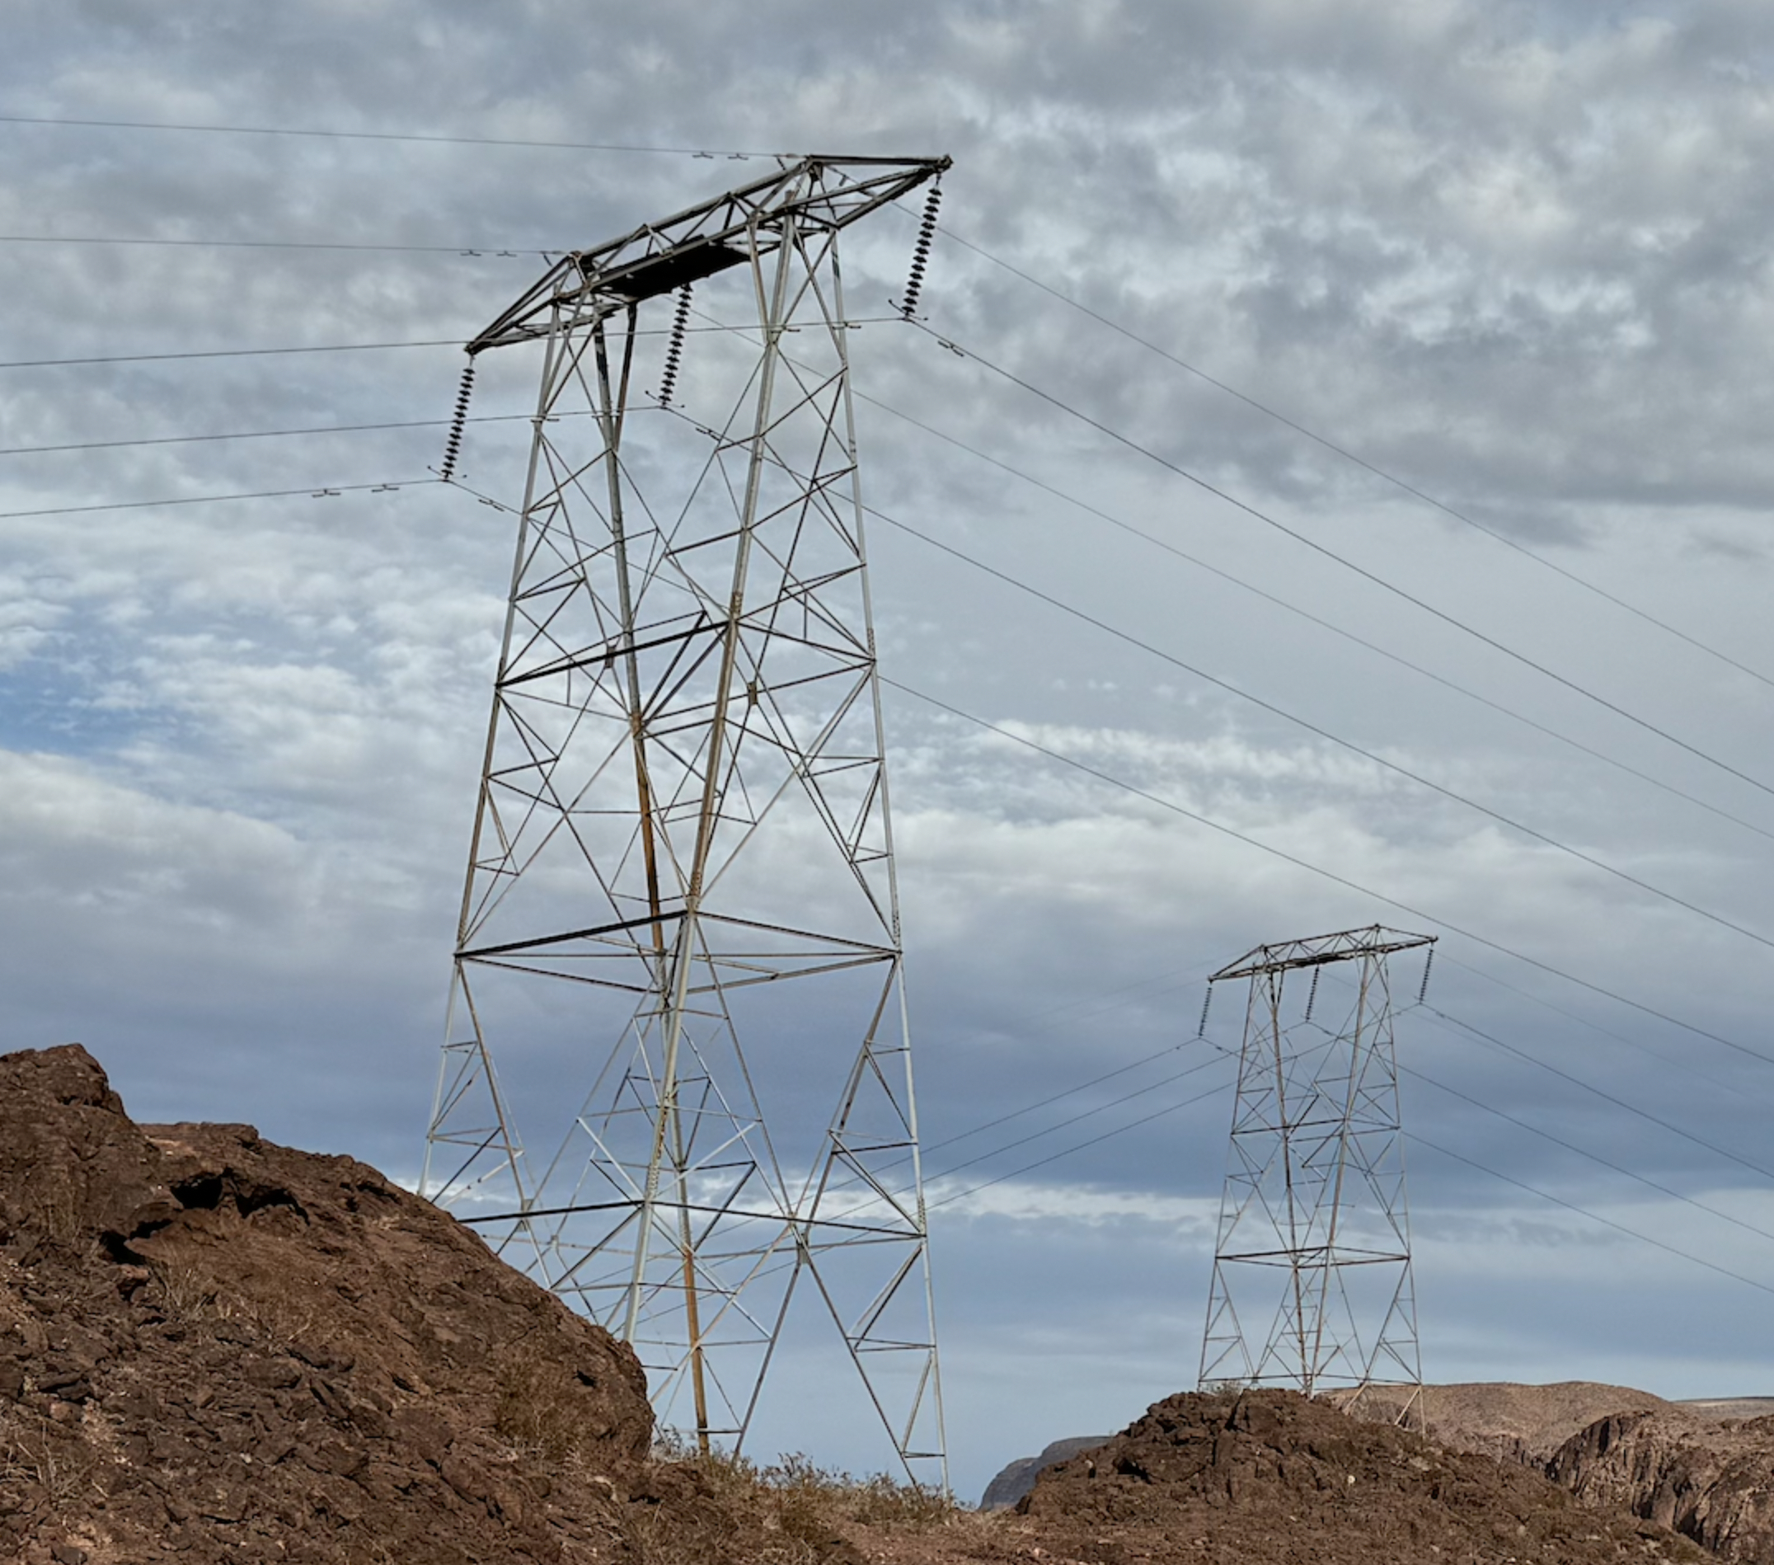
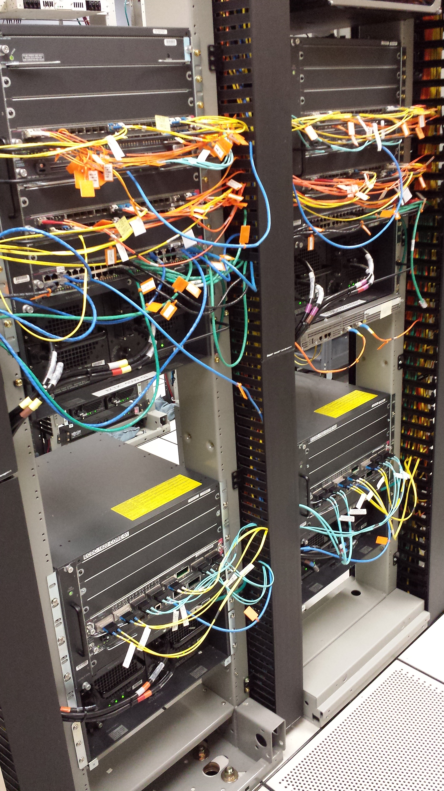
Greg Focaccio - Audience Attention
Where I work
Systems for
Strategic and Tactical
Power
Electrical
Power
Networked Information
Power
5

Slide 5
Greg Focaccio - Audience Attention
AI and Proliferation of Systems
Requires even more Networked Information Power
Systems for
AI
Power
Proliferating Systems for
Strategic and Tactical
Power
Electrical
Power
Networked Information
Power
6

Slide 6
Greg Focaccio - Personal Info
Family History
Father’s side: From Naples, to US via Ellis Island in 1880 – Great Grandfather Raffael Focaccio, Jersey City
Mom’s side: French Canadian, in US since late 1800s, Settled in Somerset, Wisconsin (Very small farming town)
Me: Native San Diegan
Father came to San Diego to visit his sister, a Navy Nurse, then decided to move here (196?)
Mom followed a school friend from Somerset to San Diego in the early 1960s
Where I live
Tierrasanta (Near Miramar Air Station)
Married to Karen for 16 years
3 Children: 12 Raffaela, 9 Dalton, 4 Isabella
3 Older Step-Children (out of the house): (Twins) 27, 27, and 29
One daughter Married to Army (rank)
One daughter Active Duty in the Airforce as GIS in Beal AFB, CA
Pets
Desert Tortoise
Small Dog – Toy Poodle mix
7

Slide 7
Greg Focaccio – Personal Info
Hobbies
Building and learning new network and system designs in garage lab
Gardening Native Plants
Camping, Hiking
Bodysurfing, Tennis
Interests
Family
Technology
Nature - Desert / Mountains / Beach
Fun Facts
I was born the same day (within the hour) as the successful Apollo 11 Moon launch <picture>
I’ve been to Egypt, drunk from the Nile, and been to the King’s Chamber in the Great Pyramid (1991)
I completed 2 Rock N’ Roll Marathons (2007, 2010) (1/2 jog, 1/2 walk)
I’ve summited San Jacinto (10,834 ft) near Palm Springs and am working towards Mt. Whitney in the next year or two
My first computer was an IBM PC with two floppy drives, ascii graphics, and BASIC (still have the computer)
In 2008 our Family caravanned (with my Dad) on a 3 day drive down Baja California to Cabo San Lucas
8

Slide 8
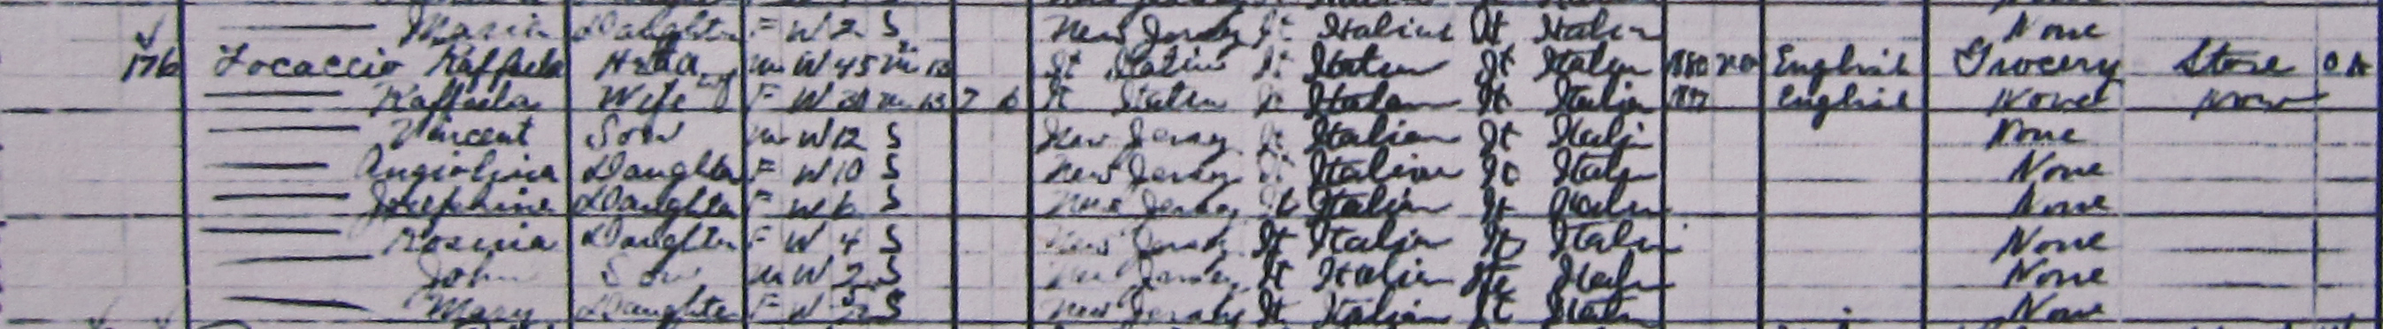

Greg Focaccio - Personal Info
Great Grandfather in US Census 1910 – Jersey City, New Jersey
9

Slide 9
Greg Focaccio - Personal Info
Maternal Grandmother with Chicken Coop – Somerset, Wisconsin
10

Slide 10
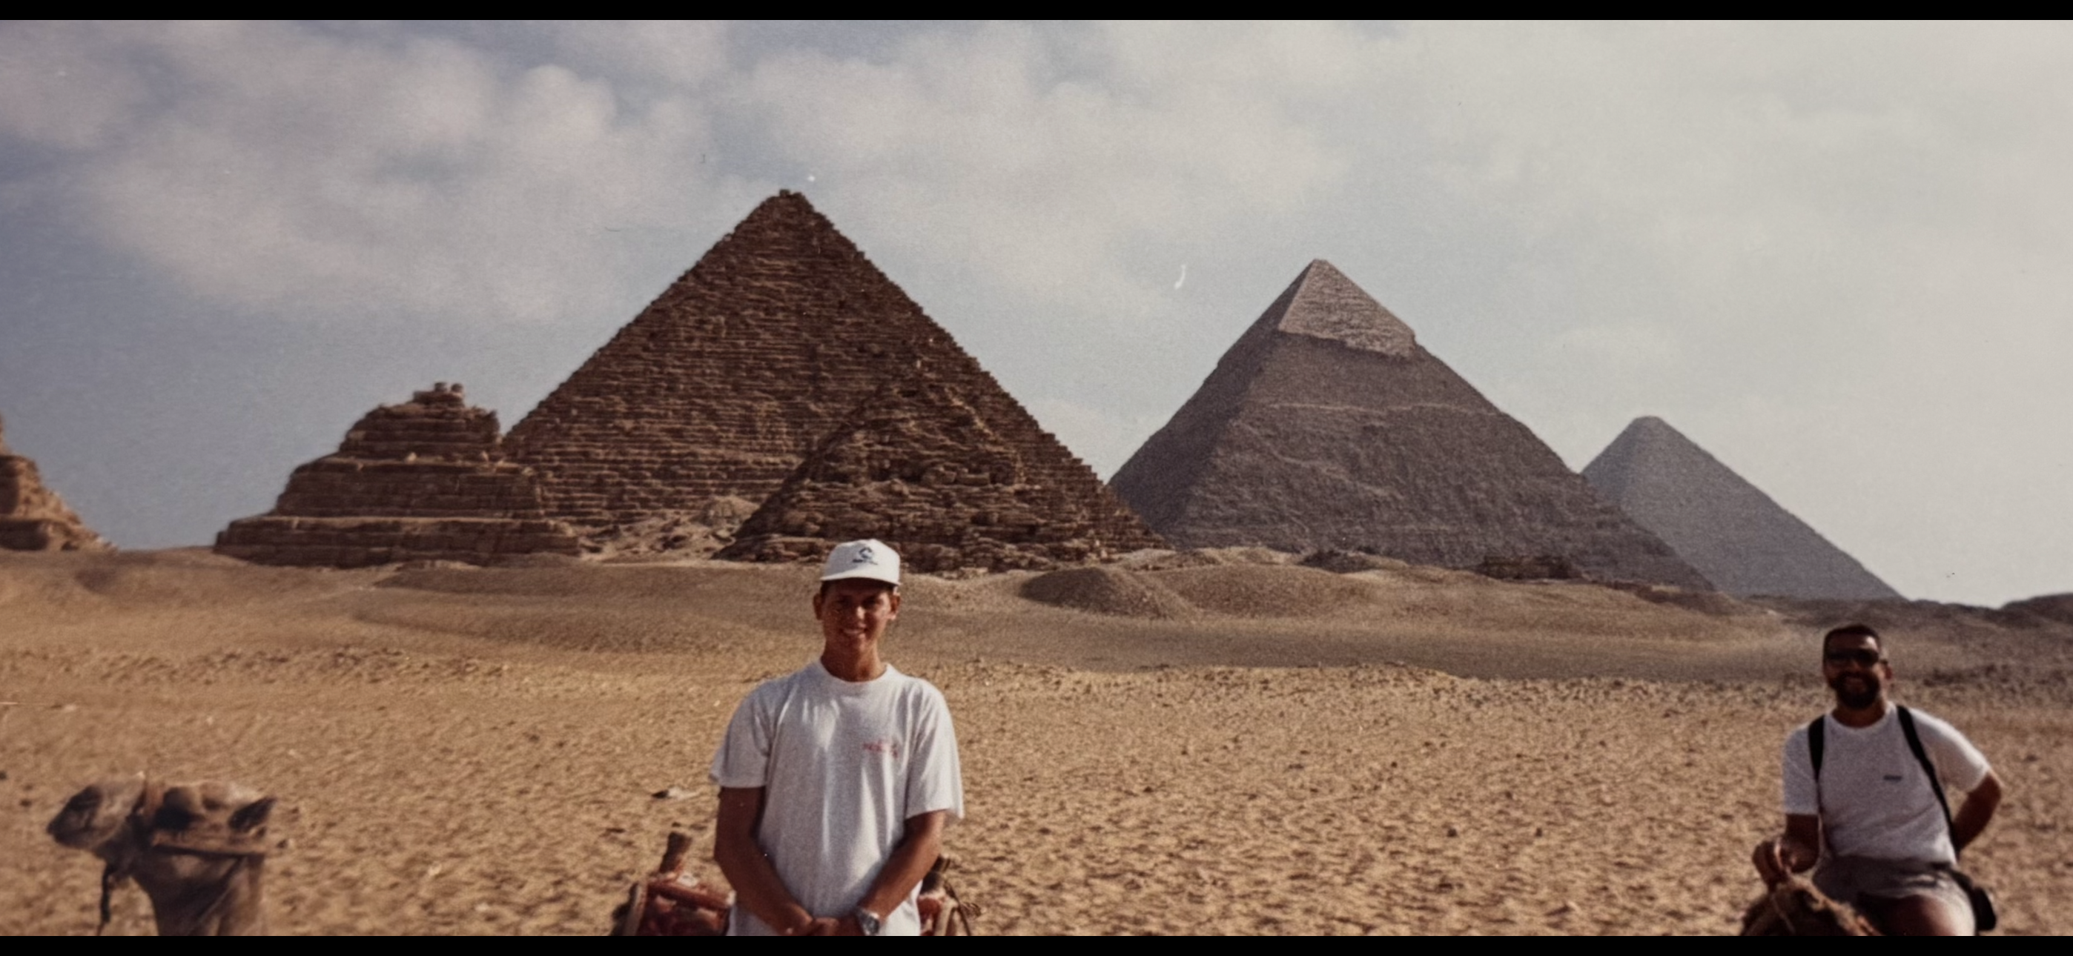

Greg Focaccio - Personal Info
Egypt with Dad
1991
Marathons
2007 & 2010
11

Slide 11
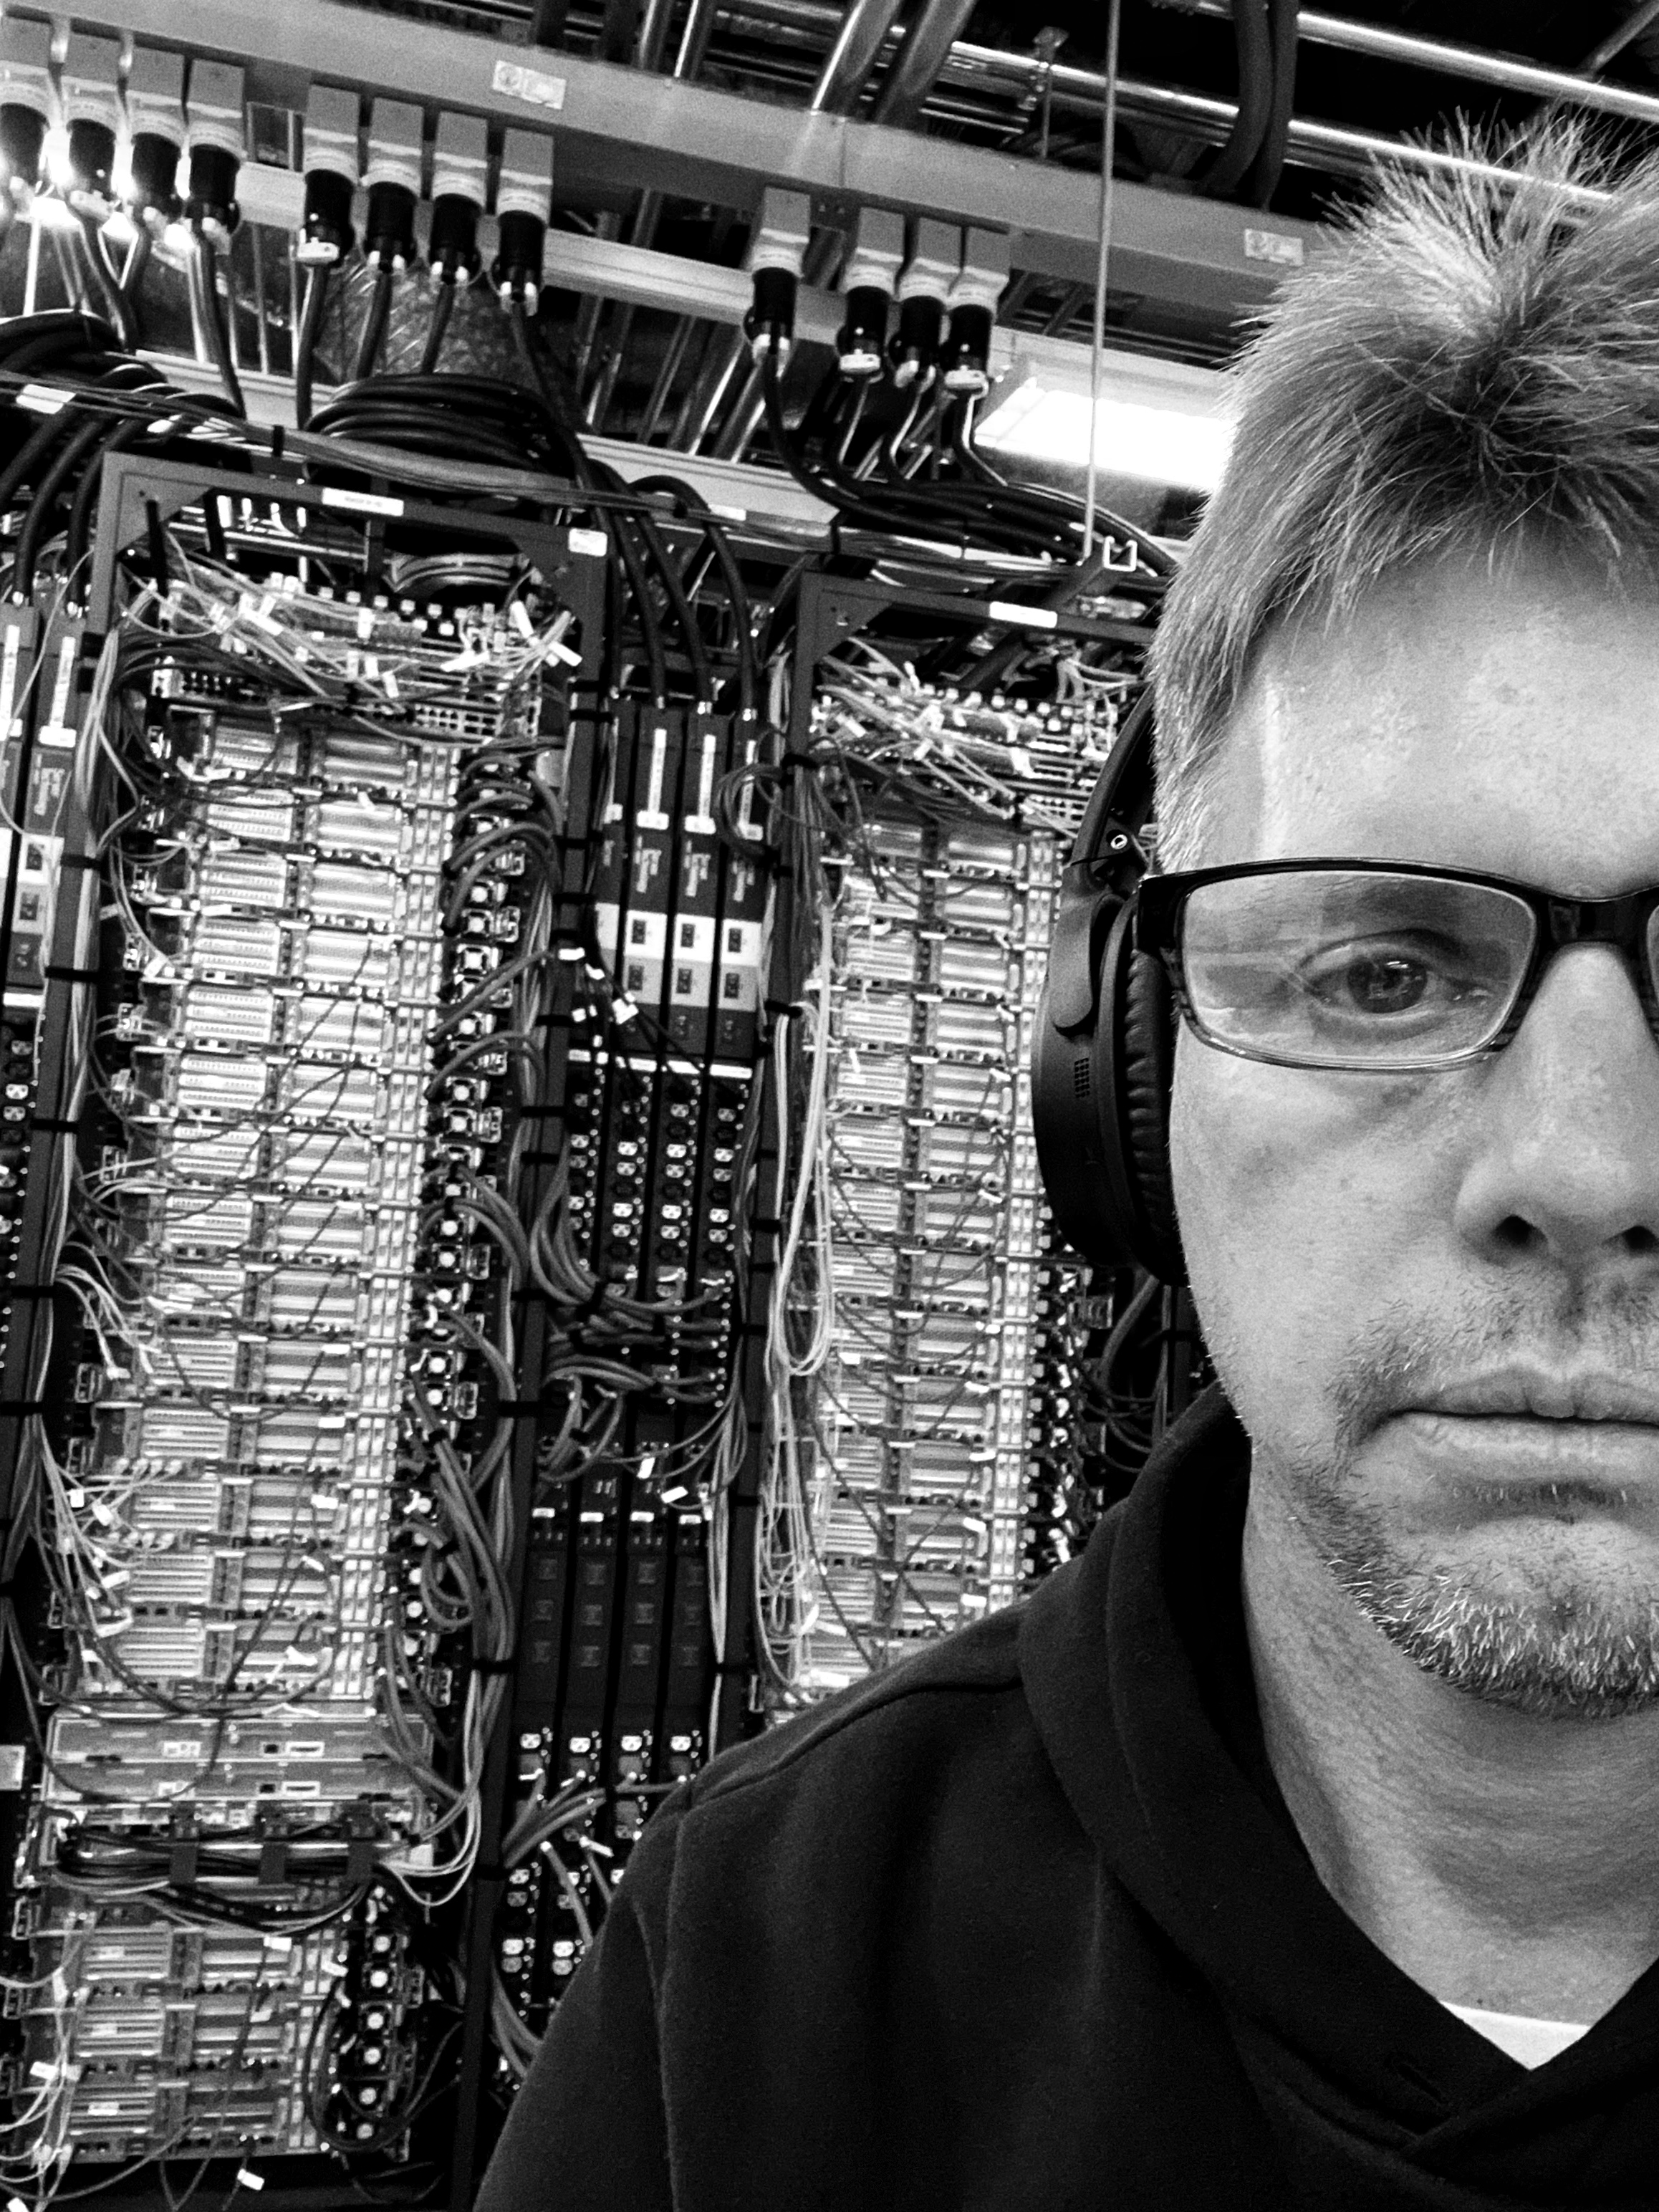
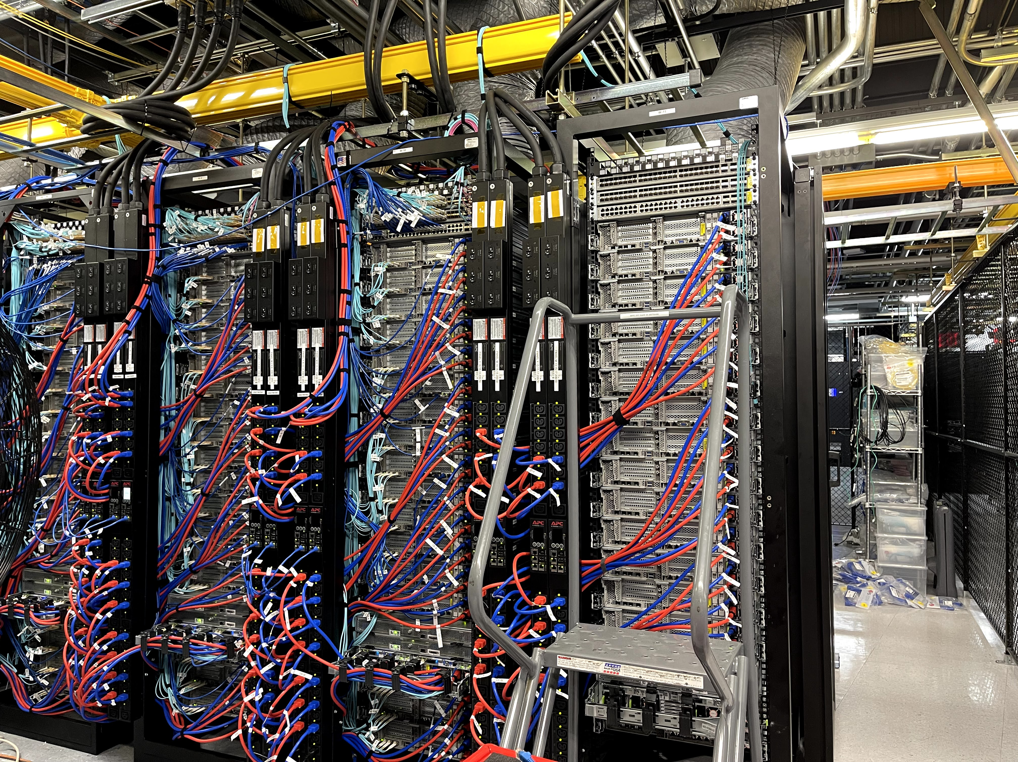
Greg Focaccio - Personal Info
Me building networks
for M5 and Meraki
Early 2020
12

Slide 12

Greg Focaccio - Personal Info
Family in Alaska
July 2025
13

Slide 13
Greg Focaccio - Professional Background
Education
Pomona College, BA Biology, Cum Laude 1991
Medical School (Incomplete) 1992-1995
Adult School / Cisco Network Academy Southwestern College
Certifications
Cisco Certified Network Professional (Last 202X)
Security Plus (Current)
Work Experience
15+ Years experience across the full spectrum of Networking work
Network Design and Engineering – Create Solutions, develop and test configurations
Network Implementation and Infrastructure - Racking, Cabling, Turn-Ups, Migrations
Network Operations - Monitoring, Management, Troubleshooting
Positions
1 Year – Principal Network Engineer – SD Datacenter ISP (M5 Hosting)
2 Years – (DoD) SIPR Transport NMCI (Perspecta) <2018-2020>
2 Year – Principal Network Engineer – SD Datacenter ISP (CARI.net)
3 Years – Senior Network Engineer – Network ISP and VoIP Provider (NextLevel Internet)
3 Years – Partner Network Engineer – Network Consulting Company (GoNet Forward)
4 Years – Junior Network Engineer – Network Services Company (Network Insight)
14

Slide 14
Greg Focaccio - NIWC PAC
4th Year at NIWC PAC – Since Summer 2021
Network Engineer with same Branch / Project
NAME and Purpose of Code/Branch
2nd Year as Navy Civilian – Since Spring 2023
My Role
Network : <Photo of Aladin network Genie – w my face
Network Design (Creation of Solutions)
Network Engineering (Configuration)
Network Implementation (Racking, Cabling, Configuring)
Network Operations (Monitoring, Management, Troubleshooting)
15

Slide 15
Greg Focaccio - NIWC PAC – Project Accomplishments
Fleet
Delivered Key Cybersecurity Requirement for Project at Major Milestone
System was accepted DATE as modernized replacement for past system within X
Engineered Cybersecurity improvement to satisfy cutover requirement
Supported initial site Cybersecurity improvement implementation at X
Delivered First Network Visibility Capability to System
Supported key external System Assessments
Test Facility (Pac X Lab)
Modernized Management of Lab Network
Added New Lab Capabilities
New wide area network (WAN) simulator
Tools and network modeling software
Enabled International Network Link to UK for key capability PA Demo
16

Slide 16
Greg Focaccio - NIWC PAC – Project Goals
Short and Mid Term
Fleet
Finish System Network Hardware Modernization
Finish follow-up Cybersecurity hardening
Improve Cyber Integrations and Automated patching
Support new key integrations and Demos
Lab
Continue conforming lab infrastructure as Fleet representative
Develop configuration automation and Testing automation
Support systems integration to enable more complete E2E environment
Long Term
Fleet
New Networks IPv6
Network IP Architecture
New Virtualized Environment
Redesign WAN connectivity architecture
Add Mature Monitoring and Management systems
Configuration Automation
New Cybersecurity Capabilities and Design
2 Factor Identity and Access Management
17

Slide 17
Greg Focaccio - NIWC PAC – Personal Goals
Short and Middle Term
Continue on Project as key Network technical performer
Mentor and train new network team member
Branch out to support other High Profile Projects
Learn more about Managerial Skills
Learn about RF, develop IP over RF network designs
Learn about Non-terrestrial network
Bring capabilities to from systems
Longer Term
Learn and begin training in Technical Team Management
Learn more about Acquisition Processes
Support NIWC PAC and NAVWAR Missions as technical team manager
Develop and participate in novel capability creation
Explore organizational design (Pure network RD w/in ST?)
18

Slide 18
Greg Focaccio - NIWC PAC
What Differentiates Me
Perspective and Gratitude
Appreciation for the earned prestige of the Center and being able to contribute to as a member of the Mission is a primary motivator, not just having a job
Career Arc Position and Continuity
Latter in my Career Arc so expect to remain with NIWC and NAVWAR
Provides level of continuity that supports more informed deciscion making
Drive for
Background rooted in Science with detail and specific data and testing orientation
Sincerity
Team player
Enjoy Travel
Accept and Enjoy Technical Challenges
Enjoy Pushing beyond and breaking new ground
Accept Difficult work
Imagination and thinking
Conceptualize new ways of doing thing
Integrations and
19

Slide 19
Greg Focaccio - Project Review
Releasable or CUI for X
Show OV1 CUI
20

Slide 20
Greg Focaccio - Project Review
Releasable or CUI for X
*What it does
*What it integrates with
*Roadmap for new capabilities
*Roadmap for new integaritions
New ST approaches
21

